Slide 1
Visual Stimulus(刺激) Disrupts(干扰) the Spatial(空间) Localization of a Tactile Sensation(触觉) in Virtual Reality
IEEE VR 2019

Slide 2
INTRODUCTION
Phantom Limb Pain(幻肢疼痛) is a common condition suffered by 45-85% of amputees(截肢患者), where a person experiences pain in a limb that is not present.
It is generally classified as Neuropathic(神经性的) in nature, which means the pain derives(源于) from the brain and other parts of the central nervous system(中枢神经系统).
There are many treatments for phantom limb pain including various pharmacological(药物的) and surgical(外科的) methods, however, cognitive(认知) methods such as Mirror Therapy (MT) and in extension, Graded Motor Imagery(电机图像分级) (GMI) have gained favor as they are non-invasive(非侵害的) and have fewer evident side effects.
Mirror therapy is the third stage in GMI and has been used as a standalone(独立的) treatment for phantom limb pain.
Mirror therapy has been translated technologically with Virtual Mirror Therapy (VMT) as the closest treatment in terms of procedure and underlying premises(基础前提). Amputees(截肢患者) are placed in a virtual environment with either a data glove(手套) or optical tracking on the intact limb. The tracking is then mapped to a digital representation of the missing limb reflected, to give the impression that it is the phantom limb which will be referred to as Virtual Mirroring. The amputee can then control their intact(完整的) limb in such a way as to attempt to alleviate(减轻) the pain in their phantom limb .

Slide 3
INTRODUCTION
Virtual mirroring and simulated extension have both shown to be useful.
Current virtual reality applications have focused on reintroducing motor cortex stimulation(重新引入运动皮层刺激) over the reintroduction of somatosensory stimulation via tactile sensation(通过触觉来重新引入体感刺激).
Although tactile sensation and movement are interlinked, they are represented differently in the brain and activation of both these areas of the brain have shown to be useful in the alleviation(减轻) of phantom limb pain.
Unlike mirror therapy where clinician will generally massage(按摩) the intact limb or stretch(伸展) the limb while reflected into a mirror to relieve pain in the phantom limb in the same way that someone would instinctively(本能地) rub(摩擦), massage or stretch(拉紧) a cramp(痉挛) in an intact limb, technological treatments have made the reintroduction of tactile sensation difficult, as commercial data gloves inhibit(禁止) the use of passive touch, which is sometimes used in mirror therapy.
Currently there is only one study that has explored the use of active touch in virtual reality specifically for use in phantom limb pain treatments. Sano found that active tactile feedback could be delivered to a phantom limb using principles from virtual mirror therapy (visuo-tactile sensation). This inclusion of active tactile sensation had a 13% increase to pain alleviating(缓解) efficacy(功效).
This study not only gives some indication that delivering tactile sensation can be accomplished in virtual reality, but it also shows that reintroducing a sense of touch holds benefits over exclusive(单独的) motor imagery or virtual mirror therapy.

Slide 4
INTRODUCTION
This type of interaction has shown to be useful in pain reduction, but it does not reflect the methods used in mirror therapy in which a clinician would touch, massage or manipulate(操作) the arm (passive touch). Passive touch, as used in some Mirror Therapy protocols elicits(引出) a greater somatosensory(躯体感觉) response than active touch may be possible. In addition, passive touch has also shown to be disproportionately(有一定比例的) better at activating neurons in the somatosensory(躯体) cortex(皮层) than active touch.
Furthermore, Sano’s paper required an intact limb in order to create the tactile perception(感知) which in some circumstances maybe an issue.
This paper aims to follow up Sano’s findings in investigating whether tactile perceptions(感知) can be transferred to a virtual arm in virtual reality in the form of passive rather than active touch.
In addition, an investigation into whether this technique has potential for simulated extension applications using visuals(视觉的) cues(线索) with decoupled(脱离) tactile stimulus, which will ultimately provide insight into visuo-tactile perceptual(感知) interfaces.

Slide 5
Phantom Limb Pain 幻肢痛
幻肢痛(phantom limb pain, PLP)是主观感觉已被截除的肢体仍然存在并有不同程度、不同性质疼痛的现象。幻肢痛是截肢患者术后常见的并发症,发生率为50%~90%。幻肢痛的病理生理机制尚未完全阐明，新近的研究提示，幻肢痛可能与大脑皮质功能重组、大脑机能改变，脊髓机能改变及外周神经机能改变有关。也有研究显示，幻肢痛与心理和记忆等多种因素有关。
Mirror therapy 镜像治疗
镜像治疗(Mirror Therapy)起源于20世纪90年代，Ramachandran于1994年最早应用镜子治疗于截肢后幻肢痛患者，后陆续有镜像治疗应用于脑卒中、外伤、慢性区域性疼痛综合征患者的报道。
镜像疗法是基于重复想象力和心理训练的一种运动表象训练，镜像疗法在视觉刺激基础上应用躯体感觉输入来辅助运动功能恢复，其方便可行、易于操作。镜像疗法可以通过将患者注意力转移到患侧肢体，增加肢体存在感并结合康复训练动作，在患侧肢体被“治愈”的错误图像刺激下，多次反复训练。
视觉作为知觉的主导，向大脑传输人体感知外界的主要信息来源。利用镜像装置，将健侧肢体活动的画面复制到患侧，患者通过这样视觉反馈，进行运动观察，模仿以及再学习。通过不断的视觉反馈刺激人脑主要运动皮质，影响皮质的电活动及兴奋性，促进脑功能重塑，诱发运动功能恢复。
通过操作性训练，增强其感受器，效应器的能力，促进本体感觉的进一步提高，治疗之前治疗师对于病人的宣教也是特别重要，其目的一方面增加可操作性和治疗有效率，另一方面给予病人心理支持，暗示等增加其主动康复的意愿。

Slide 6
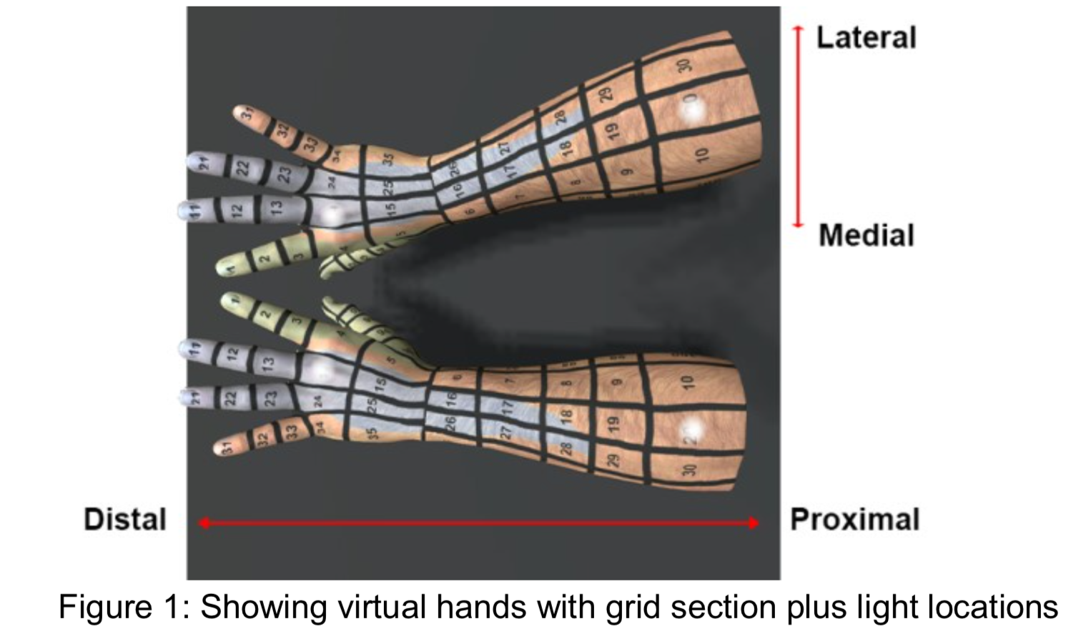
DESIGN
Following principles from mirror therapy there will be an investigation into whether a passive tactile perception can be relocated down the arm towards the fingers from the forearm(前臂) (distally(远侧的)) or to the opposite arm (contralaterally(对侧的)) by using an innocuous(无害的) visual cue(线索) with a decoupled(脱离的) vibrotactile(振动的) stimulus.
Non-amputees will be used in this quasi-experiment(准实验) to establish whether visuo-tactile interactions are possible with this protocol.
A within subjects(实验对象) repeated measures study was created in which participants viewed virtual arms which were textured(纹理), such that the skin surface was divided into distinct sections.
A vibrotactile(振动的) sensation (passive) was delivered to one of 4 positions on the arms. During some conditions, a virtual light was located on in 1 of 4 positions. The location in which the participant felt the vibrotactile sensation was recorded. A distribution of the responses was then visualized in a heat map.
Distal：远端的，Proximal：近端的
Lateral：侧面的，Medial：中间的

Slide 7
PARTICIPANTS
A total of 16 adults with intact limbs participated in the study (10 female 6 male), with an age ranging 22-57 (M= 32.9, SD=8.8).
13 participants were right-handed, two were left-handed and one person was ambidextrous(双手).
The exclusion(排除) criteria(条件) for this study were: Visual impairments(损害), visual field epilepsy(癫痫), heightened tactile defensiveness(触觉敏感), any known tactile discrimination(辨别) deficits(缺陷) or recurrent(复发)/chronic(慢性) pins and needles(手脚发麻) or numbness(麻木) in the arms.
All participants gave written consent(同意) to take part in the study and for results to be published.

Slide 8
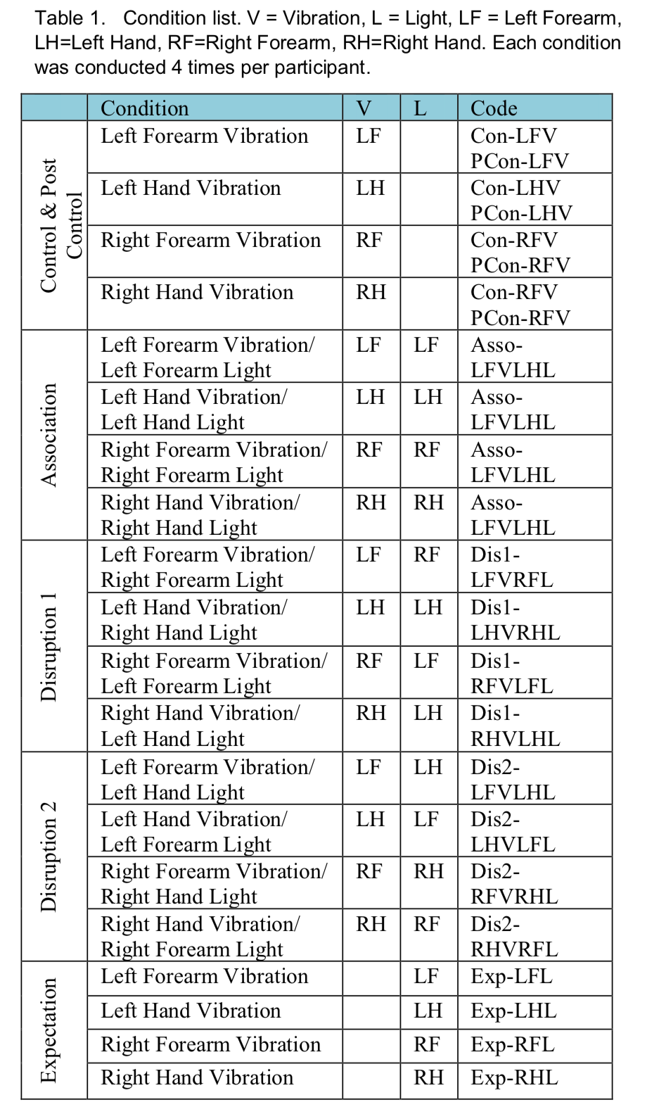
CONDITION AND GROUPS
Conditions were categorized into groups: Control, association, disruption 1 & 2, expectation, and a post control group.
The control group (including the post control group) was vibrations(振动) without any lights. This was used to gauge(测量) where the participants felt the vibrations(振动) and to situate(定位)/calibrate(校正) the baseline location of the tactile perception.
The Association group comprised(包含) of vibrations and lights located in close proximity(接近) to each other. The vibration and light were not directly collocated(控制) so as to disrupt(干扰) the localization from the control condition. This stopped participants creating a biased(有偏见的) pre-picture(预图) of the situation but also linking the light with the vibration.
There were two disruption groups, one group where the lights were decoupled(脱离) from the vibrations contralaterally(对侧地) (on the opposite arm) and the other either proximal(近端的) or distal(远端的) on the same arm.
In the Expectation phase lights were used without vibrations.
During a pilot study(试点研究) it was found that repeating over 100 trials caused an issue with arm fatigue(疲劳) so the amount of trials per participant was constrained(限制) to under 100 trials. Each group had 4 conditions and each condition was conducted 4 times per participant, totaling 96 trials per participant. 4*4*16=96

Slide 9
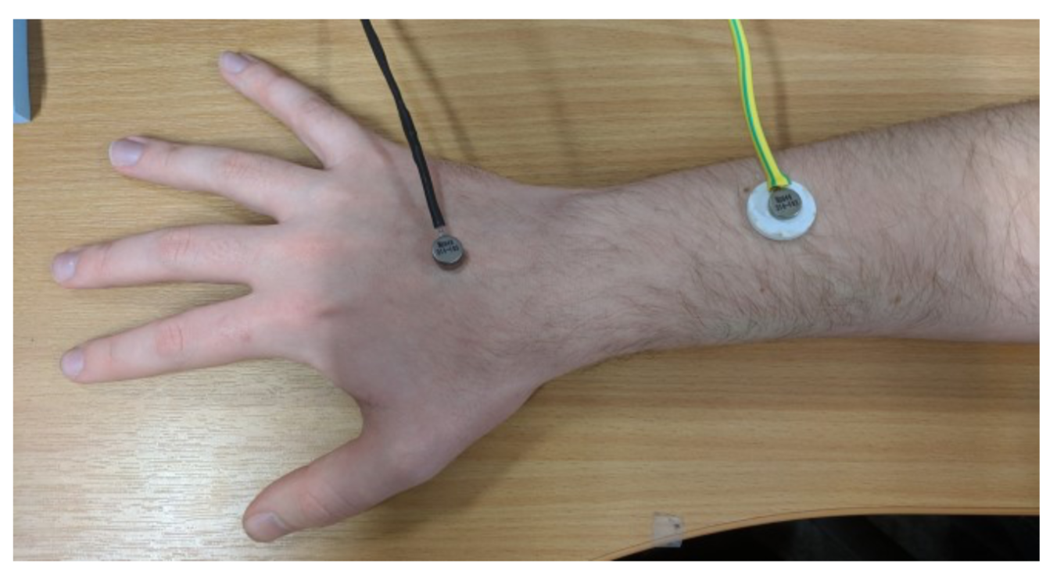
MATERIALS AND APPARATUS(材料和设备)
The application was created in Unity and assets created in 3ds Max 2015. An Oculus Rift CV1(头显)was used to display the virtual environment for the participant. A LEAP motion device(体感控制器) was used to track the participants hands and mapped the movement to the arms in the virtual environment (VE). Attached to these arms were four virtual lights (switched off by default). The lights were situated on the hand (between the middle and ring finger knuckles(指关节)) and the forearm on the left and right sides respectively. The lights were luminous(发光的) icosahedrons(二十面体) with a diameter of 1cm.
Physical vibration(振动) modules were attached to the participant’s arms using medical grade adhesive(医用胶带).

Slide 10
Virtual Environment
Participants had a choice of either male or female arms. Sections followed anatomical(解剖学) landmarks(界标) such as fingers, wrist and knuckles(指关节). The arms were divided into 100 sections in total. These sections were not equal in size as however each section was big enough for the vibration modules to fit into, the sections went from 1 to 100 wrapped(覆盖) around the arm.
The sections were set in numerical order up the arm for easier identification. A colored(彩色的) overlay(覆盖物) was placed on the hands and forearms that represented the c6 and c8 dermatomes(表皮) for validation(校准) on some sections, to mitigate(减轻) human error in reporting which was evidenced in the pilot study(试点研究).
There is little evidence to suggest(没有证据证明) this colouring(多色彩) would influence relocation of the vibrotactile sensation however caution(谨慎使用) in findings will be taken.

Slide 11
Task
Conditions were triggered(引起) on a button press, once triggered, the preset(预置装置) combination of lights and/or vibrations(振动) were presented to(反馈给) the participant depending on the phase(阶段) the participant was in.
The participant was asked to state the section number location in which they felt the vibration. They were also asked to give any other comments(评论) about the experience after each condition. They were asked to keep the entire virtual arm in view(视野) for the duration of the study. Participants were able to move their arms throughout the study, but they were asked to not make any sudden(突然) or large movements, this limited the amount the cables moved(限制线缆的移动量) and kept the tracking stable. Visual observations were made by the lead researcher to make sure this was the case(条件).
To alleviate(减缓) arm fatigue(疲劳), enforced breaks were issued after trials 23, 39 and 59. This break was issued in the middle of a group(小组中间) as to not disrupt the flow(流动) of the groups and to control for rhythm tendencies(节奏感) in participants. During the break’s participants were asked to lower(放下) their arms to their sides(两侧) for a minimum of 30 seconds, so they had time to recover from any arm or neck(颈部) fatigue(疲劳).

Slide 12
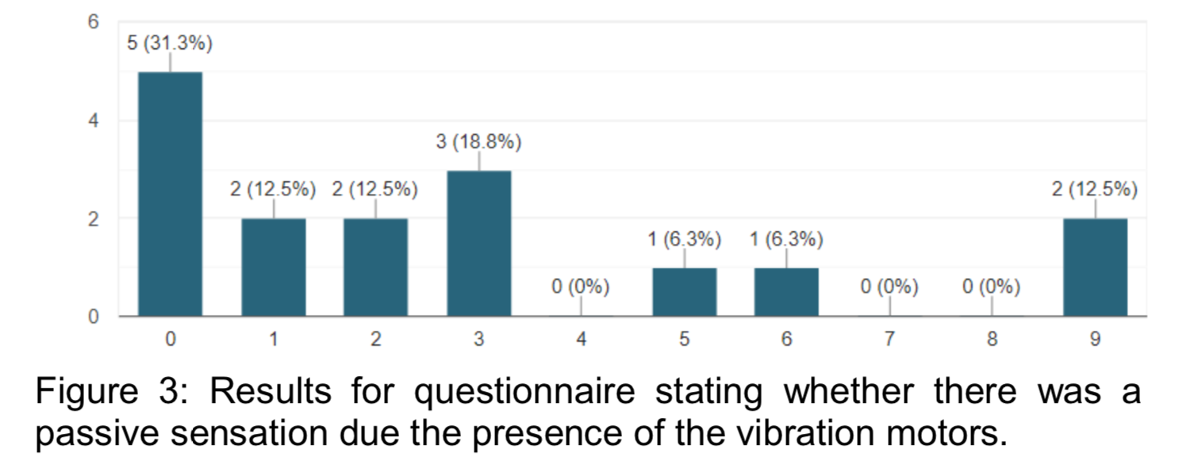
RESULTS
All conditions showed participants were able to accurately locate the vibrotactile stimulus(振动刺激) however it was evident in the heat maps that a displaced(取代) visual stimulus in virtual reality can disrupt accurate spatial(空间) perception(感知), as the distribution(分布) of response(反应) had high variance(变化) towards the virtual stimulus.
In order to check whether participants were stating the position of the vibration modules based on the inactive sensation(不振动) on their skin, a post questionnaire at the end of the study asking people “how aware were you of the vibration modules when they were not vibrating?” on a scale of 0-9 was issued with 0 being unaware of them all together and 9 being aware of them.
The results show that the majority of the participants were not very aware of the vibration modules on their skin when they were not vibrating which means they were not stating the locations of vibration modules and were stating where they felt the vibrations.

Slide 13
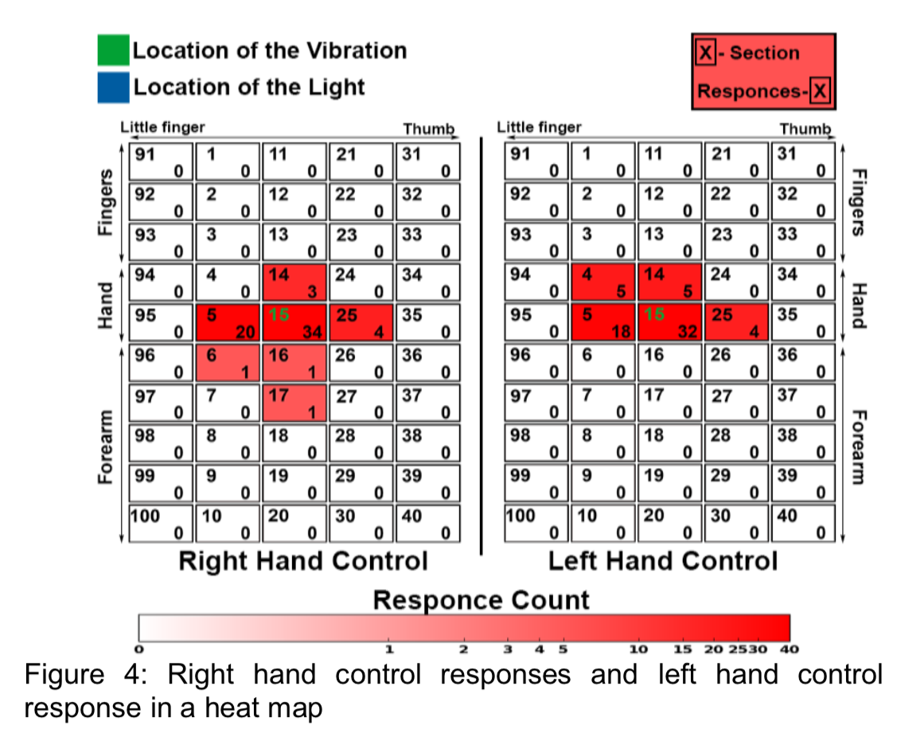
CONTROL
Within the control condition where no light was present responses were centered(中心) around the physical vibration location(物理振动).
For both the right and left hand control conditions, 64 responses were recorded.
For the left and right forearm control conditions 62 responses were recorded.
Mode(方式) of responses: Left forearm = section 17, Left hand = section 15, Right forearm = section 17 and Right hand = section 15.
Distribution around these modes were generally adjacent sections. There were responses in the proximal(近端) positions (closest sections) on the forearms where the light would have been in a different condition.

Slide 14
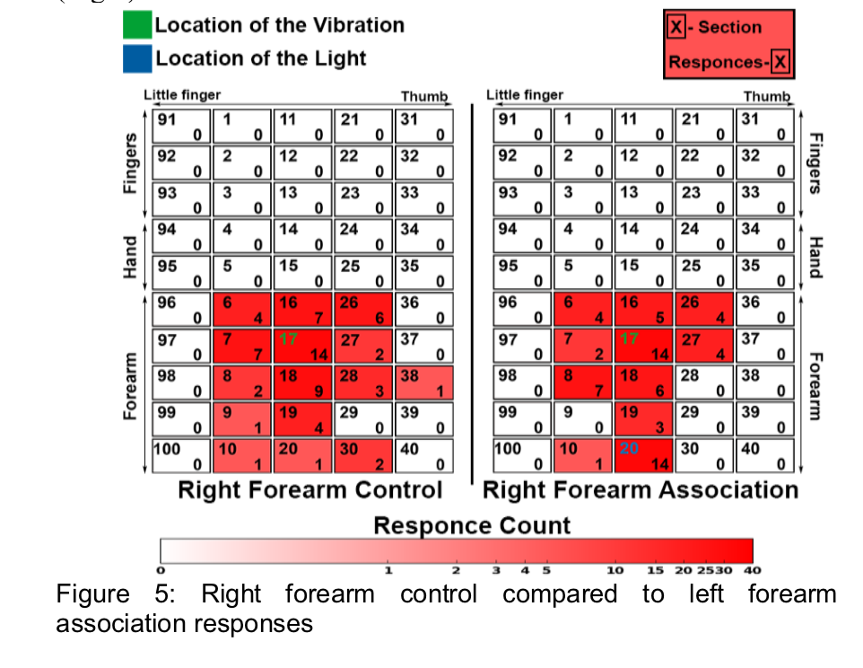
ASSOCIATION
In the association condition, where the visual stimulus was present in close proximity to the physical stimulus(视觉刺激和物理刺激非常接近的地方), responses were centered around the physical vibration location.
For both the right and left hand association conditions, 64 responses were recorded.
For left forearm association condition 62 responses were recorded and for the right forearm 62.
Mode: Left forearm = section 17, Left hand = section 15, Right forearm = section 17 and Right hand = section 15, however there was a large redistribution(重新分布) of responses towards the visual stimulus especially on the forearm responses.

Slide 15
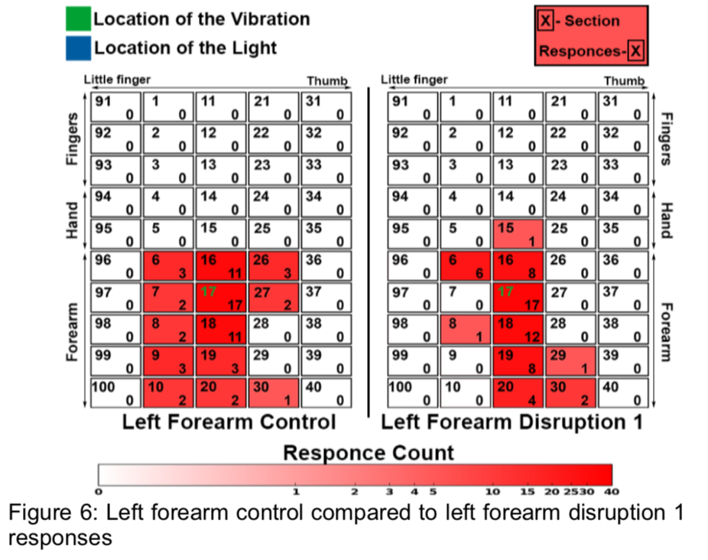
DISRUPTION 1
In the disruption 1 condition, where the visual stimulus was presented on the contralateral side(对侧), responses were centered around the physical vibration location.
For both the right and left hand Disruption 1 conditions, 64 responses were recorded.
For the left forearm Disruption 1 condition 60 responses were recorded and for the right forearm 64.
Mode: Left forearm = section 17, Left hand = section 15, Right forearm = section 17 and Right hand = section 15.
Distribution of responses were similar to their control counterparts(副本) on all sites apart from(除了) on the left forearm where there was a drastic(剧烈的) redistribution(重新分布) towards the C8 dermatome(皮片).
The left hand also had an anomalous result(异常结果) however this was only 1 response.

Slide 16
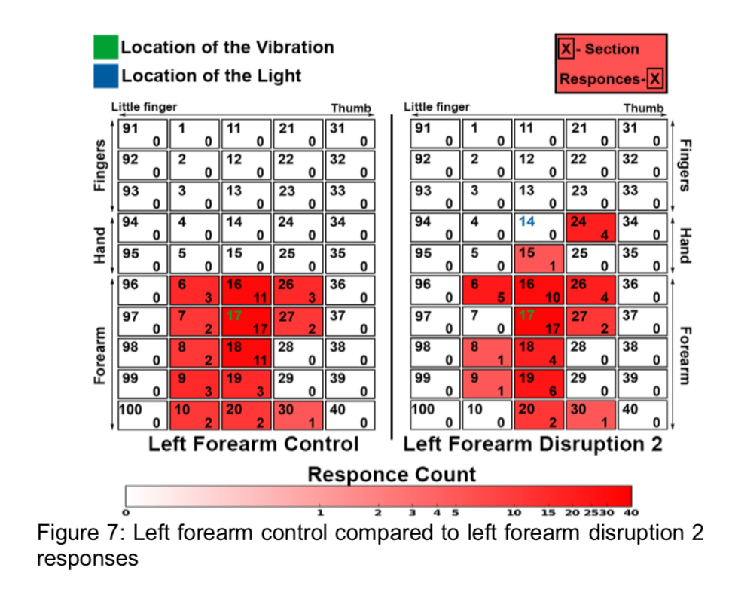
DISRUPTION 2
In the disruption 2 condition, where the visual stimulus was presented either proximal(近端) or distal(远端) from the vibration stimulus, responses were centered around the physical vibration location.
For both the right and left hand Disruption 2 conditions, 64 responses were recorded.
For the left forearm Disruption 2 condition 58 responses were recorded and for the right forearm 64.
Mode: Left forearm = section 17, Left hand = section 15, Right forearm = section 17 and Right hand = section 15.
The left forearm had many more responses near the hand where the visual stimulus was located (section 14), which was not observed on any other condition on the left forearm.
When the vibration(振动) was present on the hands and the visual stimulus was present on the forearms there was also a disruption of accurate tactile perception(触觉感知) towards the visual stimulus on the forearm.

Slide 17
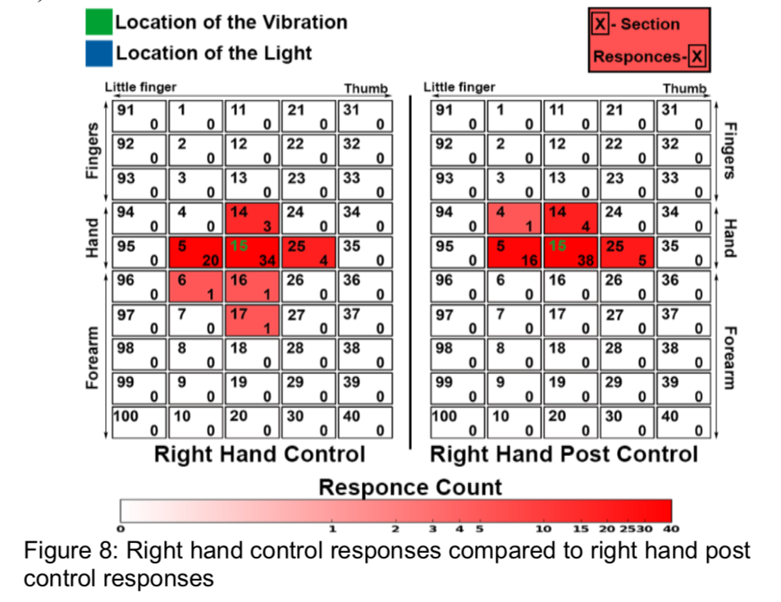
EXPECTATION
In The expectation condition, where the visual stimulus was presented with no vibration stimulus(振动刺激), there were no responses apart from one isolated case(孤立的部位) where a participant felt something in section 5 on their left hand when the visual stimulus was presented on their left hand.
POST CONTROL
Within the control condition, where no light was present, responses were centered around the physical vibration location.
For both the right and left hand Post Control conditions, 64 responses were recorded.
For the left forearm Post Control condition 60 responses were recorded and for the right forearm 64.
Mode: Left forearm = section 17, Left hand = section 15, Right forearm = section 17 and Right hand = section 15.
Compared to the control, the post-control responses were more accurate at pinpointing(指出) the physical vibrotactile sensation.

Slide 18
DISCUSSION
The results suggest that visual stimulus in virtual reality can disrupt(干扰) accurate spatial localization of a vibrotactile sensation(触觉振动). This disruption(干扰) of tactile sensation seems to follow(遵循) the location of a visual stimulus(视觉刺激的定位). This finding corroborates(证实) and expands on some of the findings in the rubber hand(橡胶手) illusion(幻觉) and mirror therapy.
Disruption 2 had some of the most profound(意义深远的) responses on all positions especially the forearms, with responses on the hands when the physical vibrotactile(振动) sensation was presented on their forearms.
This study did not corroborate(证实) findings from virtual mirror therapy where contralateral(对侧) tactile decoupling(触觉去耦) was achieved. Sano et al. provided evidence that contralaterally(对侧) relocating a tactile sensation via(需要) visual stimulus was achievable.
The results of this study demonstrated(表明) a cross modal interaction(交叉作用) between vision and touch however it did not demonstrate a substitutional(取代) experience.
Further investigation into whether a stroking(抚摸) device may change the efficacy of inducing(引起) this visuo-tactile interaction(交互). Additionally, time between stimulations(刺激之间的时间) may have had an impact(影响) on the ability to substitute(取代) the visual stimulus for a tactile sensation.
This paper demonstrates(证明) that visual capture(视觉捕捉) of a tactile stimulus(触觉刺激) may be possible in virtual reality for use in phantom limb pain treatment using a decoupled(解耦) visuo-tactile interface, however further investigation is needed.

